Slide 1

EE 272 Digital Systems
Fall 2019
Instructor: Dr. Aashir Waleed
Lecture 4 – 1
Lecture 4 Combinational Logic

Slide 2
Lecture Overview
Lecture 4 – 2
 Combinational circuits
 Design procedure and analysis skill
 Circuit examples
 XOR gates and Odd/Even parity circuits
 Equality/inequality functions
 Binary adder and subtractor
 Binary multiplier
 magnitude comparator
 Decoder and encoder
 Multiplexer and demultiplexer
 Reading Assignments:
 Chapter 4

Slide 3
Combinational vs Sequential Logic
Lecture 4 – 3
 Combinational Logic
 Outputs are solely determined by the inputs
 Represented by a truth table
Inputs
Combinational Circuit
Outputs
 Sequential Logic (contains memory elements)
 There are feedbacks and clocks
 Outputs are determined by the inputs and feedbacks at clocks
 Represented by a state-transition diagram or flow chart
Clocks
Inputs
Next-state Combinational Circuit
Finite States
Output Combinational Circuit
Outputs
Feedbacks

Slide 4
Design Procedures:
Lecture 4 – 4
 Understand the project specifications
 Express the input and output relations in truth table
 In general (or multi-level logic),
 Derive the Boolean Expressions from the truth table
 Use Laws of Boolean Algebra for logic simplification
 In two-level logic,
 Re-express the truth table in the K-Map
 Read out the simplified Boolean expressions from the K-map
 Map the simplified Boolean expressions to digital circuits
 CAD tool simulation
 Implement the design by components
 Selections of components
 Digital design is more of an art than a science
 The creative spirit is critical in combining primitive elements in new ways to achieve a desired function.

Slide 5
Code Conversion Example
Lecture 4 – 5
 Understand the specifications: BCD to Excess-3
 Binary Coded Decimal (BCD) has 4 bits and 10 numbers
 Excess-3 code has a value that excesses 3 of BCD
 Express in a truth table
 (ABCD)₂ for the inputs and (WXYZ)₂ for the outputs
BCD code A B C D
Excess-3 code W X Y Z
0 | 0 | 0 | 0 | 0 0 1 1
0 | 0 | 0 | 1 | 0 | 1 | 0 | 0
0 | 0 | 1 | 0 | 0 | 1 | 0 | 1
0 | 0 | 1 | 1 | 0 | 1 | 1 | 0
0 | 1 | 0 | 0 | 0 | 1 | 1 | 1
0 | 1 | 0 | 1 | 1 | 0 | 0 | 0
0 | 1 | 1 | 0 | 1 | 0 | 0 | 1
0 | 1 | 1 | 1 | 1 | 0 | 1 | 0
1 | 0 | 0 | 0 | 1 | 0 | 1 | 1
1 | 0 | 0 | 1 | 1 | 1 | 0 | 0

Slide 6
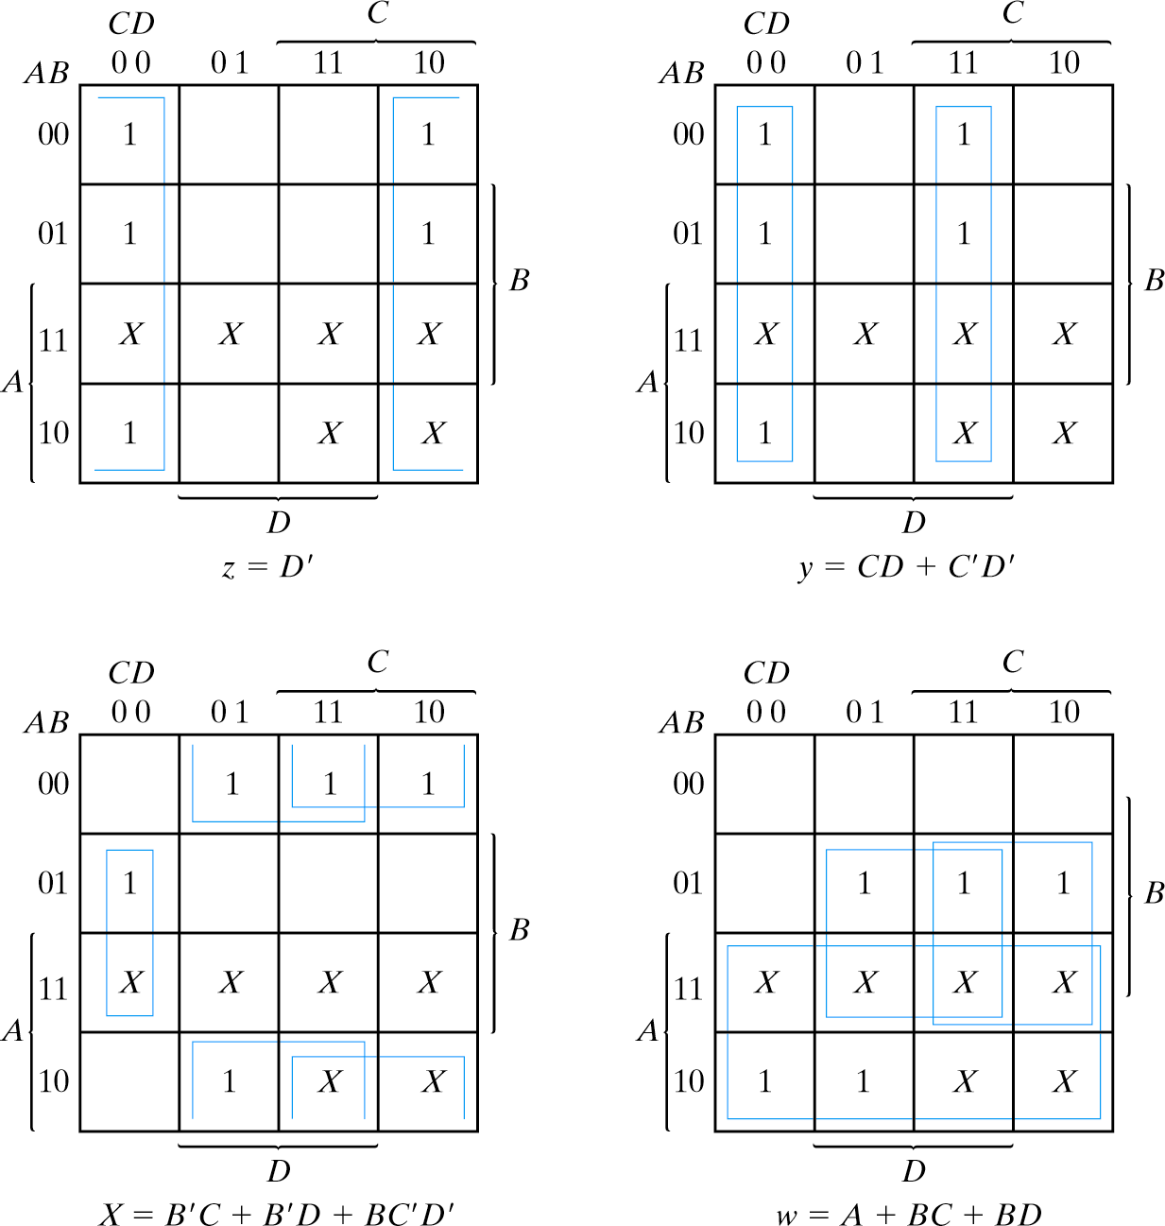
Code Conversion Example, K-map
Lecture 4 – 6
 Re-express in the K-map
 Note the ABCD placement
 Incompletely specified functions
 Read out the most simplified Boolean expressions
 How many literals?
 1+4+7+5=17
 How many TTL gates?
 How many equivalent gates?

Slide 7
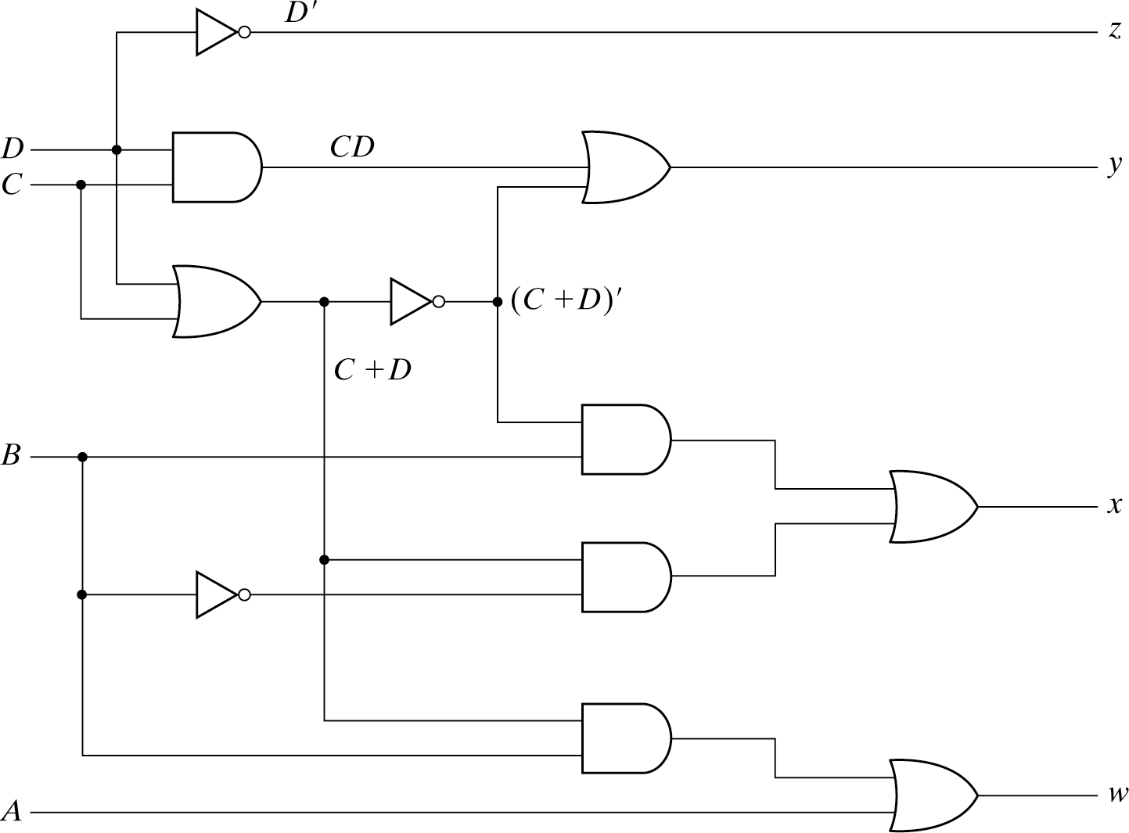
Code Conversion Example, Circuits
Lecture 4 – 7
 Map the Boolean expressions to digital circuit
 in AND-OR (two-level), or some other forms (multi-level)
 The algebraical manipulation is possible, but not recommended
z = D’
y = CD+C’D’
= CD+(C+D)’
x = B’(C+D)+B(C+D)’
= B’C+B’D+BC’D’
w= A+B(C+D)
= A+BC+BD

Slide 8
Common Combinational Logic
Lecture 4 – 8
 Simple gates
 Inverter,AND, OR (primitive gates, Boolean operations)
 NAND, NOR (basic building blocks)
 Complex gates
 XOR, XNOR (inequality and equality gates)
 Special gate
 AOI (TTL building block)
 Popular functions
 Binary adde/subtractor, comparator, encoder/decoder, multiplexer/demultiplexers
 Special features
 buffer, open-collector, tri-state
 Important CMOS build block
 CMOS transmission gate
 for multiplexer/demultpilexer (and sequential logic

Slide 9

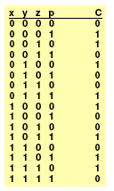
Parity generation & parity check
Lecture 4 – 9
 Odd/Even functions are useful in error detection
 Parity bit can be transmitted/stored together with the data
 Single-bit error can be detected
 Example:
 3-bit messages.
 3-input XOR used to generate parity bit
– 4-bits are transmitted
 4-input XOR used to check the parity.
C=1 indicates error.
 Common uses: 8-bit memory with parity bit, RS232 serial interface, etc.
 Note: more elaborate codes are used in modern communication systems

Slide 10
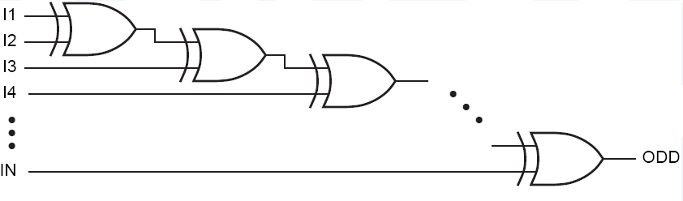
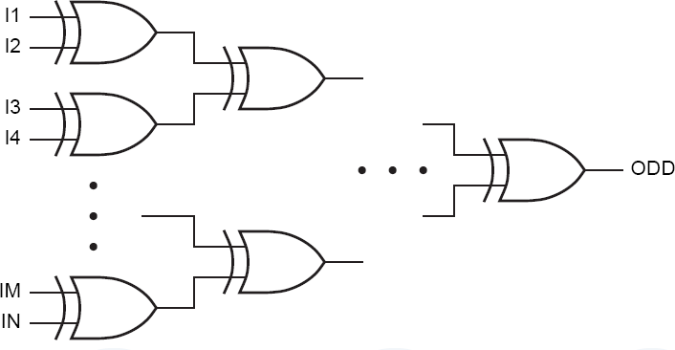
Lecture 4 – 10
Parity Circuits – EVEN Parity
 Daisy Chain (Slower)
I₁ ⊕ I₂ ⊕ I₃ ⊕□ ⊕ I_{N} = ((I₁ ⊕ I₂) ⊕ (I₃ ⊕ I₄)) ⊕□ ⊕ (I_{M} ⊕ I_{N} )
EVEN
 Tree (faster)
EVEN

Slide 11
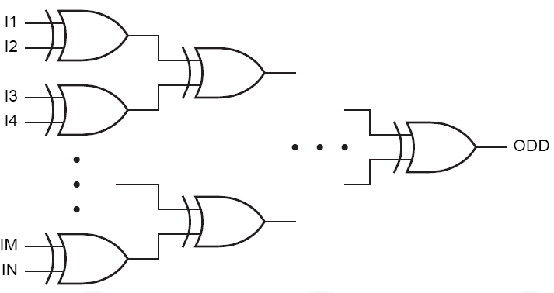
Lecture 4 – 11
Parity Circuits – ODD Parity
 Daisy Chain (Slower)
(I₁ ⊕ I₂ ⊕ I₃ ⊕□ ⊕ I_{N} )' =[((I₁ ⊕ I₂) ⊕ (I₃ ⊕ I₄)) ⊕□ ⊕ (I_{M} ⊕ I_{N} ))]'
ODD
 Tree (faster)
ODD
Also works for any ODD Number of bubbles (inverters) placed in other branches

Slide 12

XOR and inequality function
Lecture 4 – 12
 Inequality function:Y=1 if A /=B
 A and B are numbers and can have many bits
 For example, 4-bit numbers A and B
 (A3 A2 A1 A0), (B3 B2 B1 B0)
 A /= B
 if (A3 /= B3 ) OR (A2 /= B2 ) OR (A1 /= B1 ) OR (A0 /= B0 )
= (A3 ⊕ B3) + (A2 ⊕ B2) + (A1 ⊕ B1) + (A0 ⊕ B0)
 Similarly, equality function: Z = 1 if A = B A=B
If (A3 = B3 ) AND (A2 = B2 ) AND (A1 = B1 ) AND (A0 = B0 ) (A3 ⊕B3)’ (A2 ⊕B2)’ (A1 ⊕B1)’ (A0 ⊕B0)’
 The implementation can be 2-level logic
 Through a 8-variable truth table !
 But it is simpler to implement this using XOR/XNOR gates)

Slide 13










Lecture 4 – 13
Inequality function
 N-input OR gate needed for N-bit numbers

Slide 14









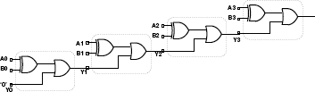
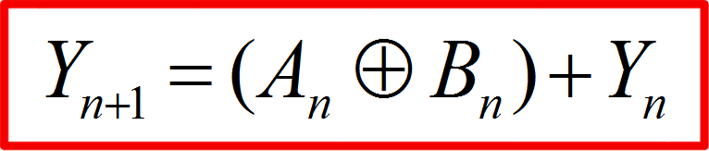
Lecture 4 – 14
Inequality function – iterative version
 Cascade 1-bit stages
Y₄
Y₄ = (A₃ ⊕ B₃) + Y₃
Y = 0
0
Y₃ = (A₂ ⊕ B₂ ) + Y₂
Y₂ = (A₁ ⊕ B₁) + Y₁
Y₁ = (A₀ ⊕ B₀ ) + Y₀
Modular design, can be easily extended to N bits
But slower than the “parallel” version
N-input OR gate is replaced with a cascade of N 2-input OR gates
Y_{n+1} = (A_{n} ⊕ B_{n} ) + Y_{n}

Slide 15









Equality function
Lecture 4 – 15

Slide 16

















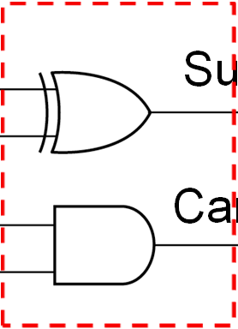
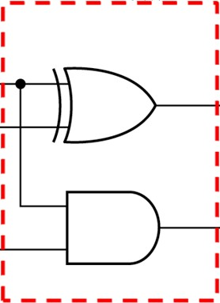
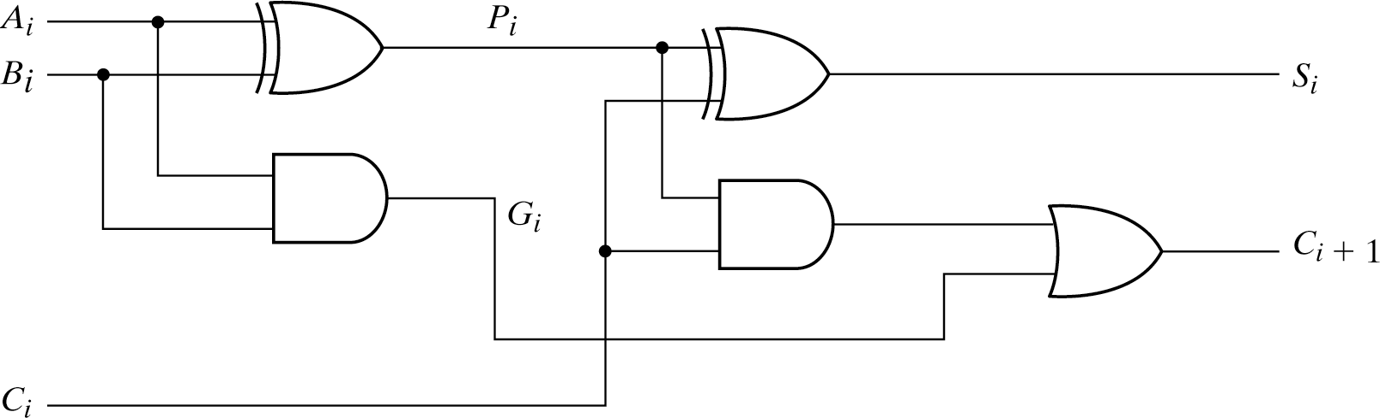
Binary Adders
Lecture 4 – 16
1-bit Half adder
1-bit Full Adder
– Adds two input bits and one Carry-in to form Sum and Carry-out
– Adds two input bits to form Sum and Carry
Truth table
A B Sum Carry
A B Cin Sum Cout
0 0
0 1
0
1
0
0
0 0 0
0 0 1
0 1 0
0
1
1
0
0
0
1 | 0 | 1 | 0 | 0 | 1 | 1 | 0 | 1
1 | 1 | 0 | 1 | 1 | 0 | 0 | 1 | 0
Boolean expression
Sum = A ⊕ B
Carry = AB
Logic gates
1 0 1
1 1 0
1 1 1
0
0
1
1
1
1
Su
Ca
m
Sum
Sum
rry
Carry
Cout

Slide 17
Two-bit Binary Adder
Lecture 4 – 17
 Specifications
 Two 2-bit input numbers, P = AB and Q=CD
 One 3-bit output number R=XYZ
 In total, there are 4 input bits and 3 output functions
 Truth table
A B C D X Y Z 0 0 0 0 0 0 0
0 1 0 0 1
1 0 0 1 0
1 1 0 1 1
0 1 0 0 0 0 1
0 1 0 1 0
1 0 0 1 1
1 1 1 0 0
1 0 0 0 0 1 0
0 1 0 1 1
1 0 1 0 0
1 1 1 0 1
1 1 0 0 0 1 1
0 1 1 0 0
1 0 1 0 1
1 1 1 1 0
A B
C D
P
+
Q
X Y
Z
R

Slide 18
Two-bit Binary Adder, Continued
Lecture 4 – 18
 K-map and the simplified Boolean expressions
 Note the ABCD placement
 AND-OR (or NAND-NAND) implementation is sufficient
 How many literals and equivalent gates?
 Algebraical manipulation is possible, but not recommended
AB
_{CD} 00 01 11 10
00 0 0 0 0
01 0 0 1 0
11 0 1 1 1
10 0 0 1 1
A A
A
AB
_{CD} 00 01 11 10
00 0 0 1 1
01 0 1 0 1
11 1 0 1 0
10 1 1 0 0
AB CD
00
00 01 11 10
0 1
1
0
01 1 0
0
1
D
D
D
11 1
0
0
1
C
C
C
0
0
10
1
1
B
B
B
K-map for X
K-map for Y
K-map for Z
X = A C + B C D + A B D
Z = B D' + B' D = B xor D Y = A' B' C + A B' C' + A' B C' D + A' B C D' + A B C' D' + A B C D

Slide 19
n-bit Binary Adder
Lecture 4 – 19
 Design a 4-bit adder (Word description)
 Adds two 4-bit binary numbers (A3 A2 A1 A0) & (B3 B2 B1 B0), to yield a 5-bit output (C4 S3 S2 S1 S0)
 Truth Table :A big table
 8 inputs and 2⁸ = 256 input combinations
 How about 16-bit adder, 32-bit adder, 64-bit adder
 2³², 2⁶⁴ and 2¹²⁸ entries for the truthtables
 Not practical

Slide 20
n-bit Binary Adder – another approach
Lecture 4 – 20
 Use bit-wise addition: 1-bit half and full adders
 For a n-bit binary adder, the half adder is used for the least significant bit (LSB), and the full adder is used for the rest of bits
 Alternatively, a full-adder could be used for LSB (with carry-in = 0)
Carry
1
1 5
+ 7
2 2 1 0 1 1 0
A3 B3
A2 B2
A1 B1
A0 B0
1 1 1 1
1 1 1 1
0 1 1 1
FA
FA
FA
HA
Carry propagation
C4 S3
C3
S2
C2
S1
C1
S0
Carry signal has to propagate through all stages for final result
This design is called a ‘ripple adder’

Slide 21
n-bit Binary Adder, Comparison
Lecture 4 – 21
 Binary adder is a common component in logic design
 Truth table method: difficult for larger n
 There are (2n) inputs and 2^{(2n)} input combinations
 Two-level logic design: Gate count (or cost) should be large
 Speed is good (only 2 or 3 propagation delays)
 Ripple Adder: By cascade of 1-bit binary adders
 Straightforward design
 Carry propagation is proportional to number of bits
 long delay time and slow speed
 Carry lookahead adder
 A structural design for n-bit binary adder
 A parallel adder to reduce the propagation delay

Slide 22
Carry Generate & Carry Propagate
Lecture 4 – 22
 For the the ith bit
 Carry Generate: G_{i} = A_{i} B_{i}
 Carry Propagate: P_{i} = A_{i} ⊕ B_{i}
 Then Sum and Carry Output of Full Adder can be expressed:
 Sum
 Carry
S_{i} = P_{i} ⊕ C_{i} C_{i+1} = G_{i} + P_{i}C_{i}

Slide 23
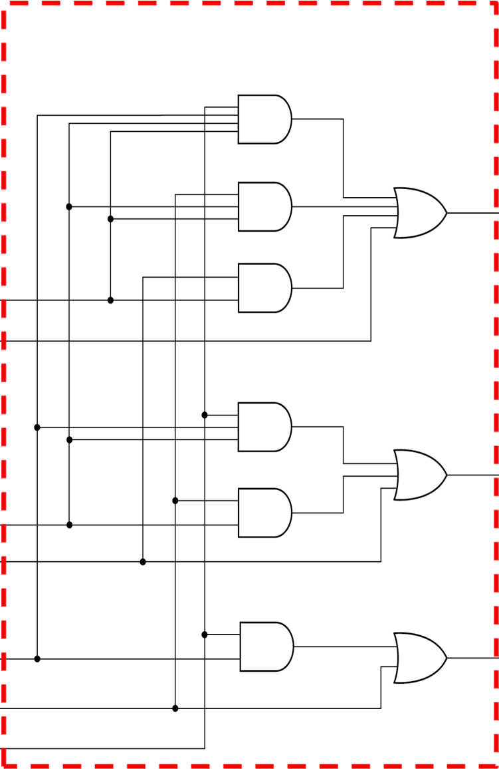
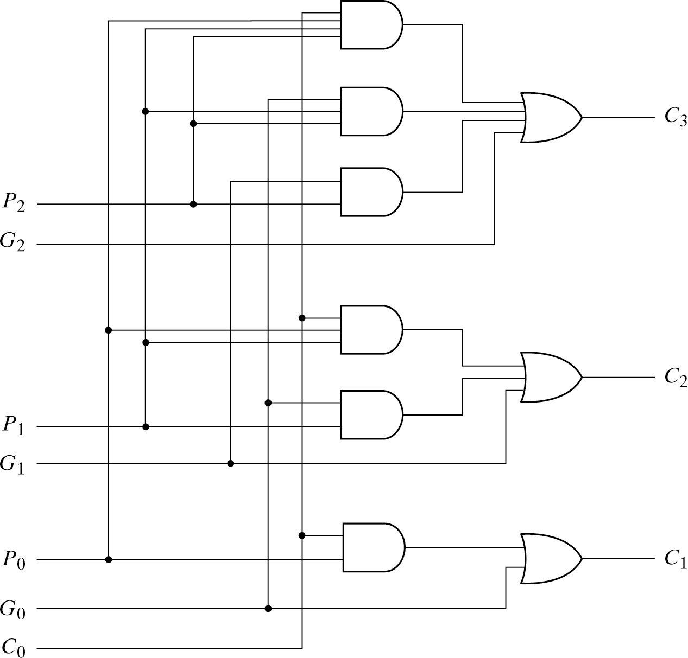


Carry Lookahead Generator
Lecture 4 – 23
 All the Carry outputs have the same propagation delay
C₄=G₃ +P₃C₃
Carry Lookahead Generator
=G₃ +P₃G₂ + P₃P₂G₁ + P₃P₂P₁G₀ +P₃ P₂P₁P₀C₀
C₃ = G₂ + P₂C₂
= G₂ + P₂G₁ + P₂P₁G₀ + P₂P₁P₀C₀
Carry
C₄ C₃ C₂ C₁ C₀
A₃ A₂ A₁ A₀
C₂ = G₁ + P₁C₁
B B B B
= G₁ + P₁G₀ + P₁P₀C₀
3 3 1 0
C₄ S₃ S₂ S₁ S₀
C_{i+1} = G_{i} + P_{i} C_{i}
G_{i} = A_{i} B_{i}
P_{i} = A_{i} ⊕ B_{i}
C₁ = G₀ + P₀C₀

Slide 24
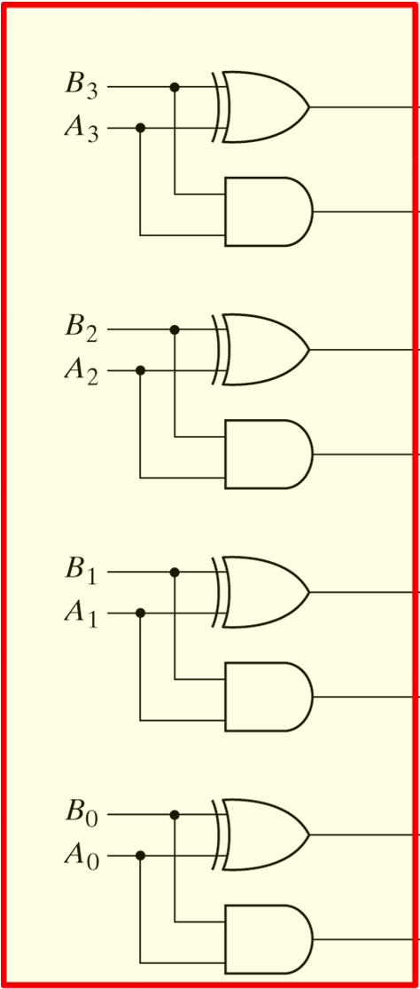
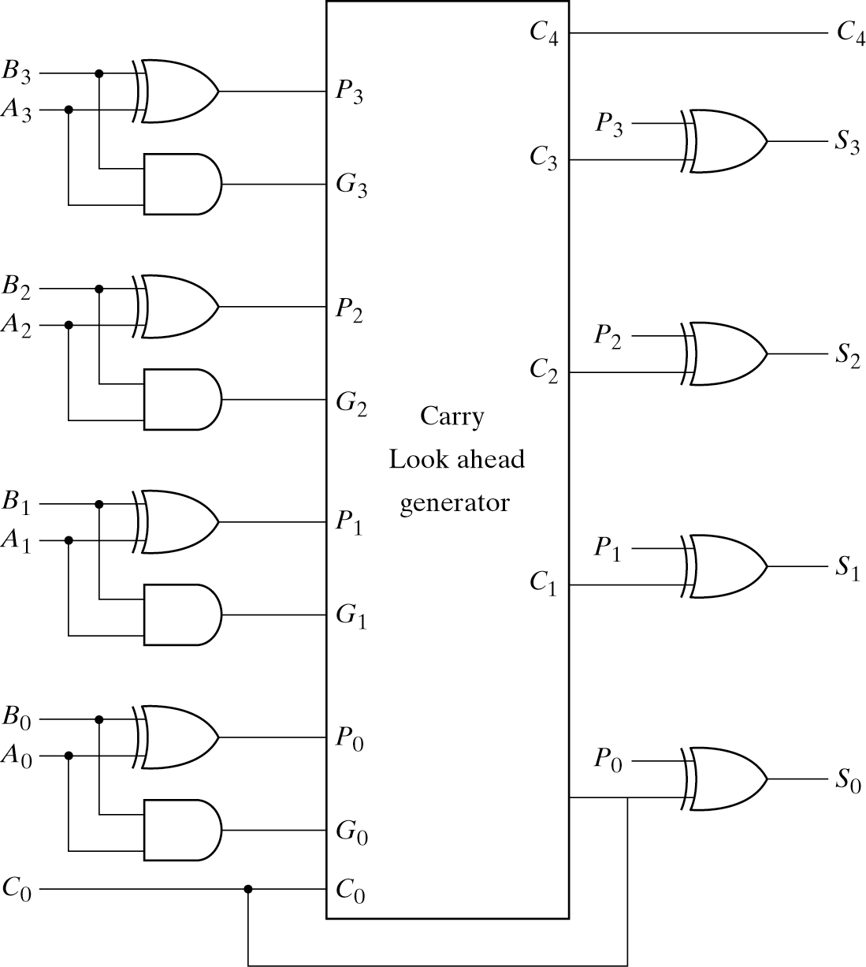
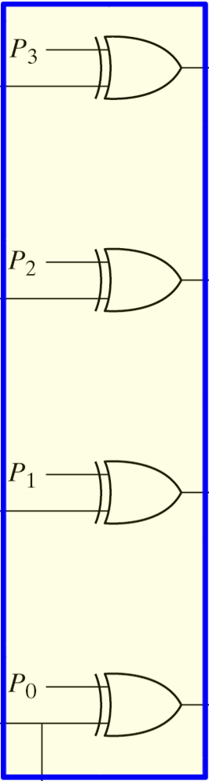
4-bit Binary Adder with the Carry Lookahead
Lecture 4 – 24
“Front-end”
half adders for Carry propagates and Carry generates
G_{i} = A_{i} B_{i}
P_{i} = A_{i} ⊕ B_{i}
to (quickly) produce all carry
“Back-end” XOR gates for sum outputs (S_{i})
S_{i} = P_{i} ⊕ C_{i}

Slide 25
Adders - summary
Lecture 4 – 25
 Ripple adder
 Simple structure – cascade of 1-bit full adders
 Slow (carry needs to propagate through all stages)
 Use Carry-Lookahead Adder
 Faster (2-level lookahead logic to generate all carry bits in parallel)
 More complex, needs more gates (i.e. more expensive!)

Slide 26

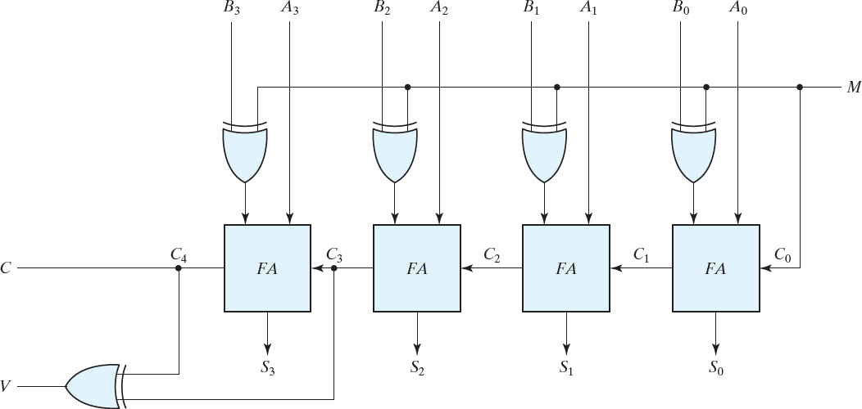
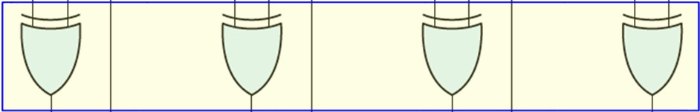
n-bit Binary Adder and Subtractor
Lecture 4 – 26
When M = 0, the circuit is an ADDER
  XOR gates act as Buffer and does NOT change the bits
When M = 1, the circuit is a SUBTRACTOR
  XOR gates act as Invertor and takes 1’ complement of B
  M = 1 is added (as Carry in) to get 2’s complement of B
  A + (2’s Complement of B) = A – B hence subtraction is done by addition
XORs Generate 1’s Complement
when M=1 (all XORs become Inverters)
Overflow detector
Add M=1 to convert 1’s complement to 2’complement of B

Slide 27
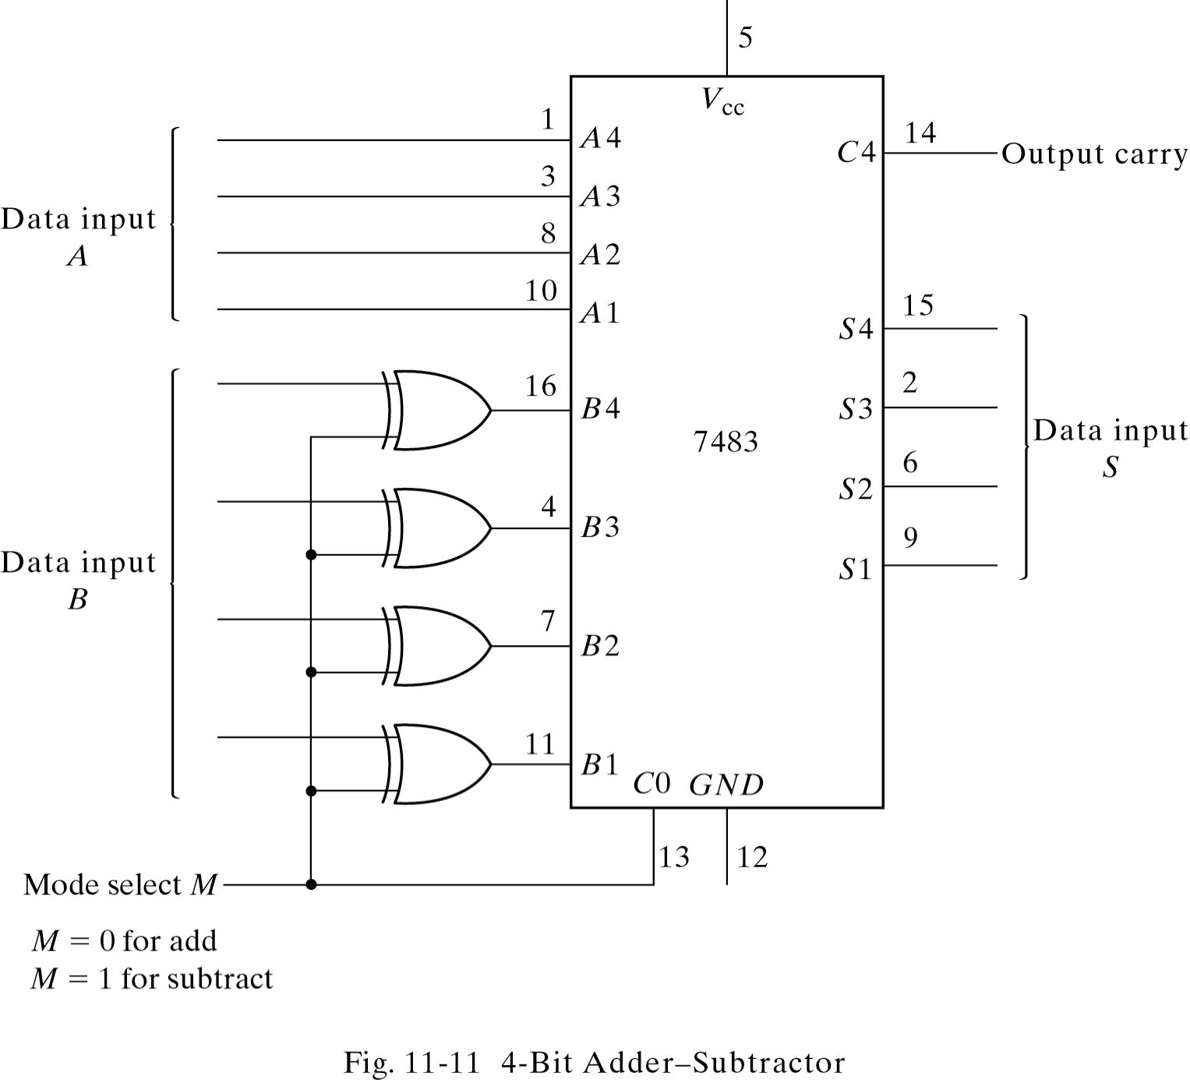
Adder, Subtractor and Magnitude Comparator
Lecture 4 – 27

Slide 28
Overflow
Lecture 4 – 28
 Adding unsigned numbers:
 A=(1100)₂ =(12)₁₀, B=(0111)₂ =(7)₁₀
 1100 + 0111 = 10011
 S=(0011)₂
 Carry-out C=1 indicates overflow
 Adding signed numbers
 A=(1100)₂ =(-4)₁₀, B=(0111)₂ =(7)₁₀
 -4 + 7 = 3 = (0011)₂
 S=(0011)₂ is now correct (no overflow) …but C=1…
 To detect overflow when adding signed numbers consider both carry-in to MSB and carry-out from MSB – overflow occurs if they are not equal
 V = C_{N} XOR C_{N-1}

Slide 29




Overflow
Lecture 4 – 29
 Adding signed numbers
 Overflow usually occurs when adding two numbers, both with the same sign (both positive or both negative)
 Adding two numbers with opposite signs does NOT cause an overflow because the result will be smaller (closer to zero!)
Carry 0 1
Carry 1 0
0 X X X X
0 Y Y Y Y
-----------------
1 Z Z Z Z
A B
1 X X X X
1 Y Y Y Y
-----------------
0 Z Z Z Z
C
C
Both A and B positive But C is negative
Both A and B negative But C is positive
Both are wrong because 4-bit is not enough to represent the results: OVERFLOW!

Slide 30
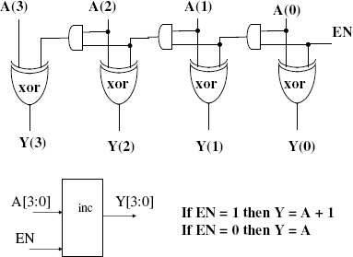
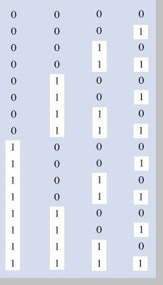
Incrementer
Lecture 4 – 30

Slide 31
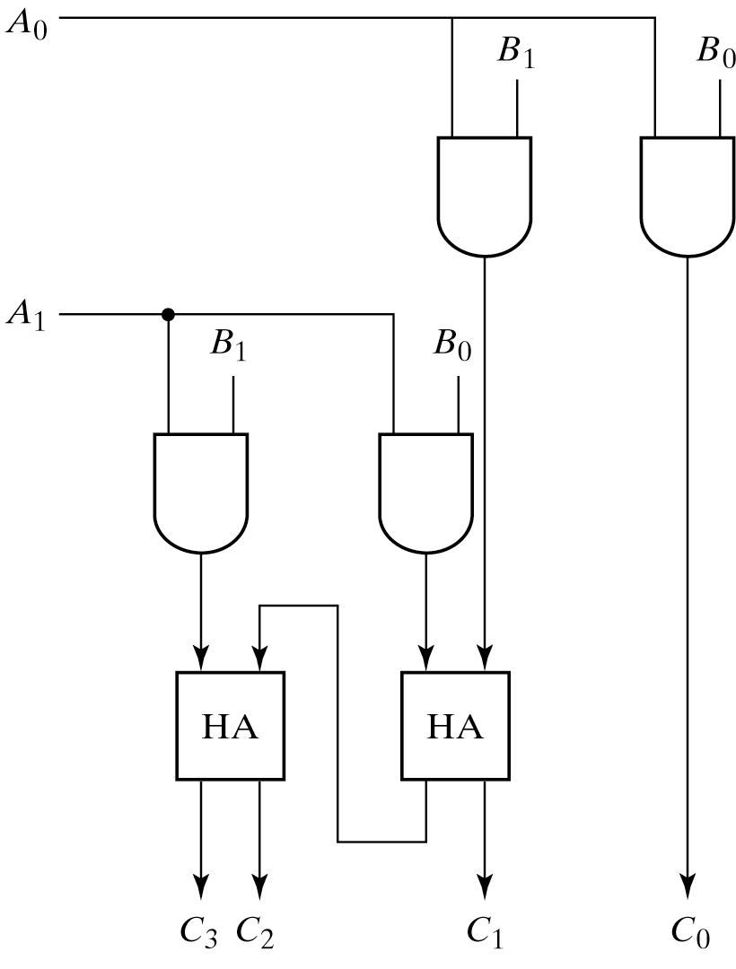
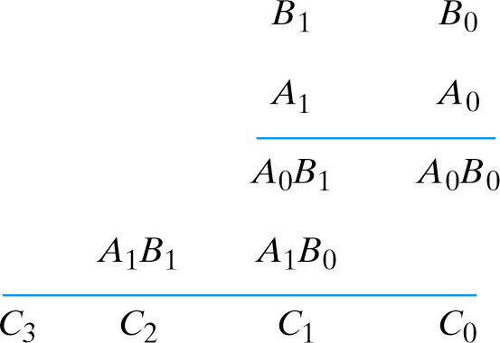
Two-bit Binary Multiplier
Lecture 4 – 31
Conventional design procedure
  4 input bits (two bits of each number) and 4 output functions
  Truth table, … …
Straightforward design
  Use binary adders

Slide 32
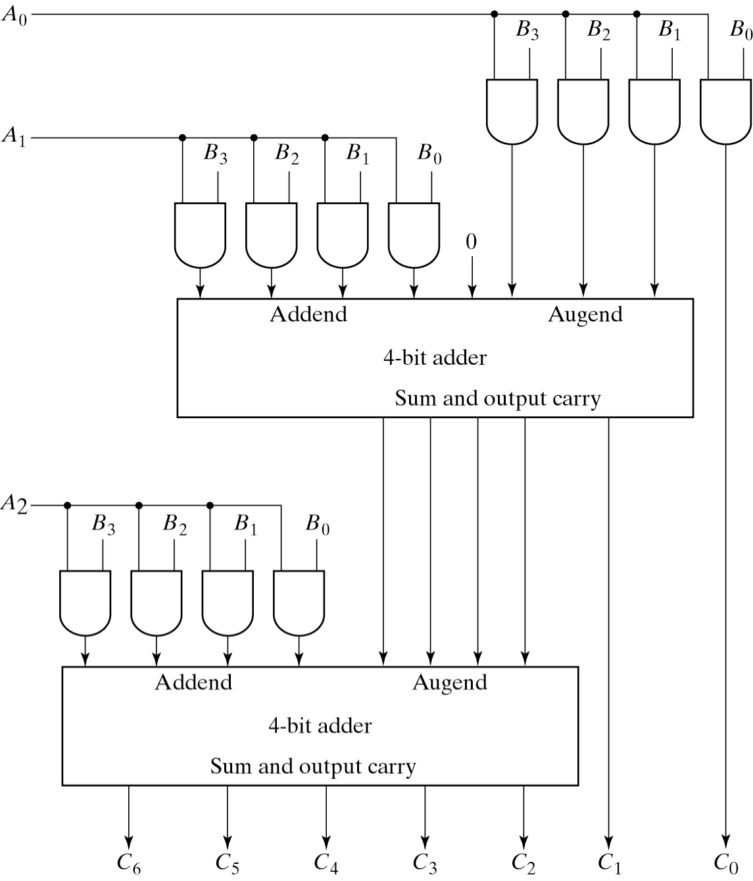
4-bit by 3-Bit Binary Multiplier
Lecture 4 – 32
 |  | B3 | B2 A2 | B1 A1 | B0 A0
 | A₁B₃ | A₀B₃ A₁B₂ | A₀B₂ A₁B₁ | A₀B₁ A₁B₀ | A₀B₀
A₂B₃ | A₂B₂ | A₂B₁ | A₂B₀
C6 C5 | C4 | C3 | C2 | C1 | C0

Slide 33
Magnitude Comparator
Lecture 4 – 33
1-bit magnitude comparator is a 2-input function
– F9 = (X⊕Y)’ | ⇒ | X = Y | (equality)
– F6 = X⊕Y | ⇒ | X ≠ Y | (in-equality)
– F2 = XY’ | ⇒ | X > Y | (larger than)
– F4 = X’Y | ⇒ | X < Y | (smaller than)
– F11 = F4’ | ⇒ | X ≥ Y | (larger than or equal to)
– F13 = F2’ | ⇒ | X <= Y | (smaller than or equal to)
X | Y | F0 | F1 | F2 | F3 | F4 | F5 | F6 | F7 | F8 | F9 | F10 | F11 | F12 | F13 | F14 | F15
0 | 0 | 0 | 0 | 0 | 0 | 0 | 0 | 0 | 0 | 1 | 1 | 1 | 1 | 1 | 1 | 1 | 1
0 | 1 | 0 | 0 | 0 | 0 | 1 | 1 | 1 | 1 | 0 | 0 | 0 | 0 | 1 | 1 | 1 | 1
1 | 0 | 0 | 0 | 1 | 1 | 0 | 0 | 1 | 1 | 0 | 0 | 1 | 1 | 0 | 0 | 1 | 1
1 | 1 | 0 | 1 | 0 | 1 | 0 | 1 | 0 | 1 | 0 | 1 | 0 | 1 | 0 | 1 | 0 | 1
0
X
Y
X+Y (X⊕Y)’
X’
(X • Y)’ 1
X•Y
X⊕Y (X+Y)’ Y’

Slide 34
Two-bit Magnitude Comparator
Lecture 4 – 34
Understand the specifications
Two input numbers, P = AB2 and Q=CD2. Each has two bits Three functions
F1 = 1 if P = Q F2 = 1 if P < Q F3 = 1 if P > Q
Truth table
A | B | C | D | F1 | F2 | F3
0 | 0 | 0 | 0 | 1 | 0 | 0
 |  | 0 | 1 | 0 | 1 | 0
 |  | 1 | 0 | 0 | 1 | 0
 |  | 1 | 1 | 0 | 1 | 0
0 | 1 | 0 | 0 | 0 | 0 | 1
 |  | 0 | 1 | 1 | 0 | 0
 |  | 1 | 0 | 0 | 1 | 0
 |  | 1 | 1 | 0 | 1 | 0
1 | 0 | 0 | 0 | 0 | 0 | 1
 |  | 0 | 1 | 0 | 0 | 1
 |  | 1 | 0 | 1 | 0 | 0
 |  | 1 | 1 | 0 | 1 | 0
1 | 1 | 0 | 0 | 0 | 0 | 1
 |  | 0 | 1 | 0 | 0 | 1
 |  | 1 | 0 | 0 | 0 | 1
 |  | 1 | 1 | 1 | 0 | 0
A B
C D
P
F1 F2
F3
Q
Q

Slide 35
Two-bit Magnitude Comparator, Continued
Lecture 4 – 35
AB CD
00
A A
A
AB CD
00
AB CD
00
00 01 11 10
00 01 11 10
00 01 11 10
1 | 0 | 0 | 0
0 | 1 | 0 | 0
0 | 0 | 1 | 0
0 | 0 | 0 | 1
0
0
0
0
0
 |  | 1 |  | 1 |  | 1
0 | 0 |  |  | 1 |  | 1
0 | 0 |  | 0 |  |  | 0
0 | 0 |  | 1 |  |  | 0
01
01 1
0
0
0
01
D
D
D
11
11 1
1
0
1
11
C
C
1
0
0
C
10
10
1
10
B
B
B
K-map for F₁
F2 = A' B' D + A' C + B’CD F3 = B C' D' + A C' + A B D’
K-map for F₂
K-map for F₃
F1 = A' B' C' D' + A' B C' D + A B C D + A B' C D’
= (AC + A’C’)(BD + B’D’) = (A xnor C) (B xnor D)
K-map and the simplified Boolean expressions Note the ABCD placement
The 2-bit equality function can be made of 2 1-bit equality gates How about the 2-bit smaller/larger-than functions?

Slide 36
4-bit Magnitude Comparator
Lecture 4 – 36
A(3:0) = (A3,A2,A1,A0)
B(3:0) = (B3,B2,B1,B0)
A>B if
A3>B3 or
(A3=B3) and (A2>B2) or
(A3=B3) and (A2=B2) and (A1>B1) or
(A3=B3) and (A2=B2) and (A1=B1) and (A0>B0)
A<B if
A3<B3 or
(A3=B3) and (A2<B2) or
(A3=B3) and (A2=B2) and (A1<B1) or
(A3=B3) and (A2=B2) and (A1=B1) and (A0<B0)
A=B if
(A3=B3) and (A2=B2) and (A1=B1) and (A0=B0)

Slide 37
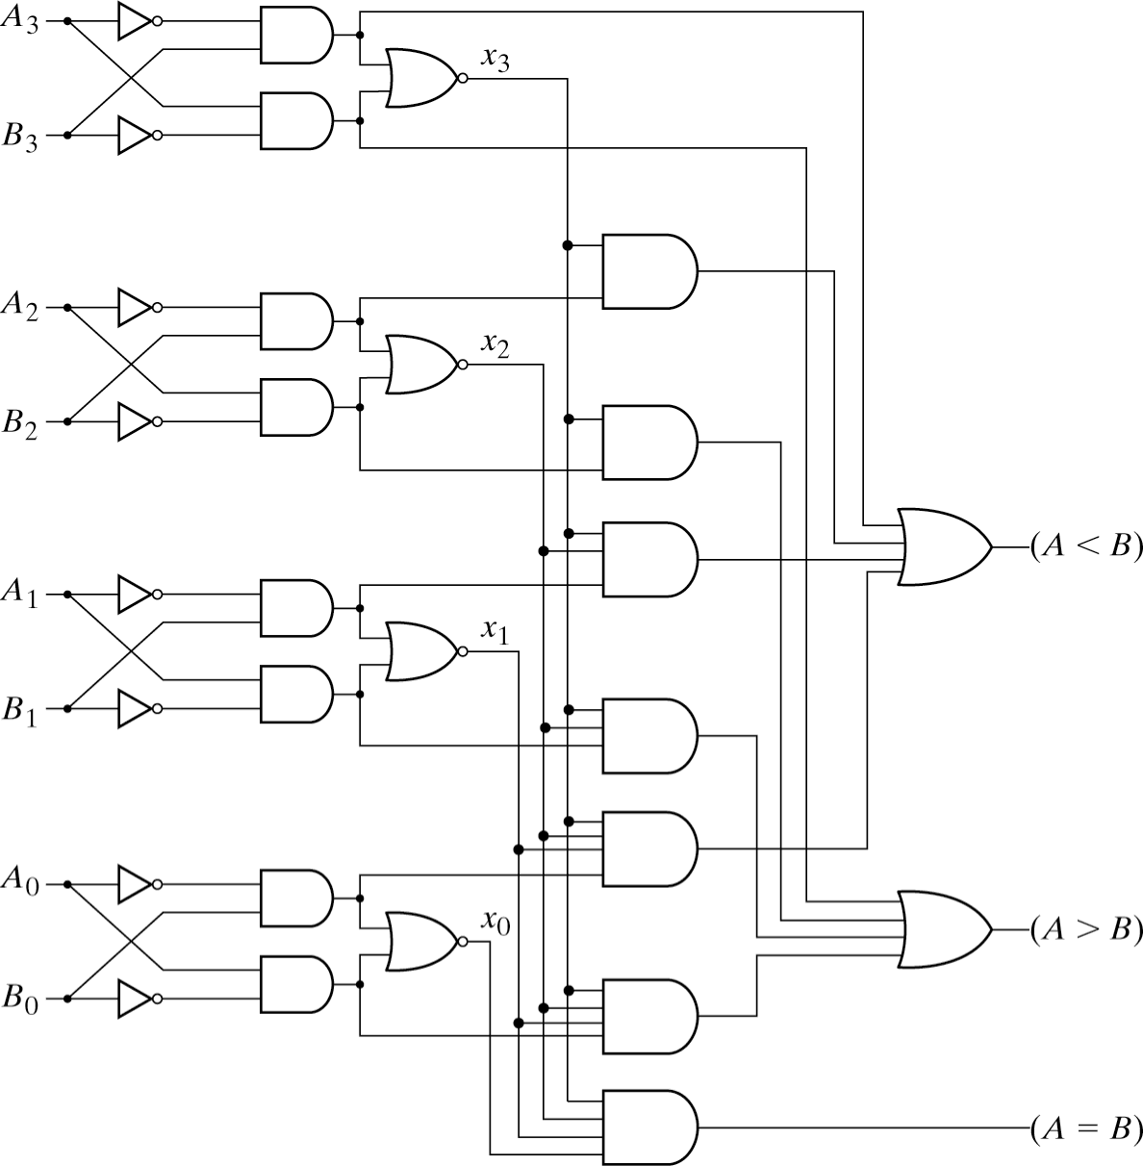
4-bit Magnitude Comparator
Lecture 4 – 37
A3’B3 (<)
(A3⊕B3)’ (=)
A(3:0) = (A3,A2,A1,A0)
B(3:0) = (B3,B2,B1,B0)
A3B3’ (>)
A>B if
A3>B3 or
(A3=B3) and (A2>B2) or
(A3=B3) and (A2=B2) and (A1>B1) or
(A3=B3) and (A2=B2) and (A1=B1) and (A0>B0)

Slide 38
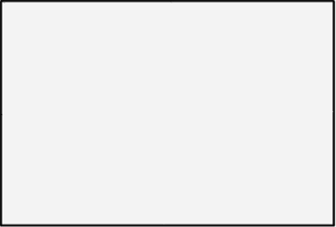

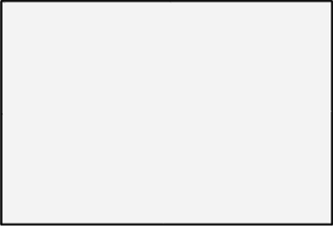
Iterative Magnitude Comparator
Lecture 4 – 38
A= 0110xxxx…. B =0110xxxx….
A = 01101xxxx…. B = 01100xxxx….
Lets start from MSB bits first
If “A=B” up until now and A_{i}=B_{i} then we still think that “A=B” is possible If “A=B” up until now, and A_{i}>B_{i} then we have a result: “A>B”
If “A>B” is already true, then we don’t need to do comparison we know that “A>B”
Eq_out_{i} =1 when A=B up to bit i AND (A_{i} = B_{i})
Grt_{i} is 1 if A>B up to bit I OR (A = B up to bit i AND A_{i}>B_{i})
^{A}i+1
^{B}i+1
A_{i}
B_{i}
^{A}i-1
^{B}i-1
Eq_in
Eq_out
Eq_in
Eq_out
Eq_in
Eq_out
Grt_in
Grt_out
Grt_in
Grt_out
Grt_in
Grt_out

Slide 39
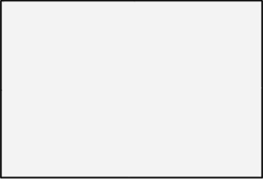
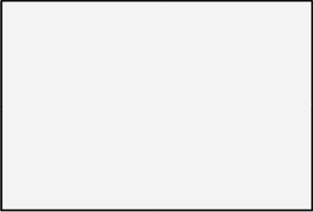
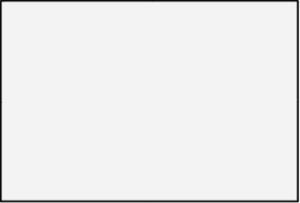
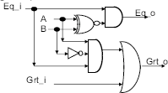
Iterative Magnitude Comparator
Lecture 4 – 39
A_{i} B_{i}
^{A}i+1 ^{B}i+1 ^{A}i-1 ^{B}i-1
A=B signal A>B signal
Eq_in
Eq_out
Eq_in
Eq_out
Eq_in
Eq_out
Grt_in Grt_out Grt_in Grt_out Grt_in Grt_out
Eq_out_{i} =1 when A=B up to bit i AND (A_{i} = B_{i})
Grt_{i} is 1 if A>B up to bit I OR (A = B up to bit i AND A_{i}>B_{i})
Eq _ out_{i} = Eq _ out_{i+1} AND (A_{i} = B_{i} )
Grt _ out_{i} = Grt _ out_{i+1} OR (Eq _ out_{i+1} AND (A_{i} > B_{i} ))
Logic Implementation of each iterative block
Eq_in
Eq_out
Eq _ out_{i} = Eq _ in_{i} (A_{i} ⊕ B_{i} )'
Grt _ out_{i} = Grt _ in_{i} + (Eq _ in_{i} (A_{i}B_{i} '))
What about A<B?
Grt_out
Grt_in

Slide 40
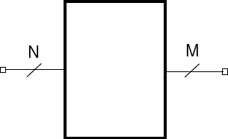
Decoders and Encoders
Lecture 4 – 40
Change one binary code into another
  Decoder: M>N, Encoder: M<N
  Typical Decoder: N-to-2^{N} (binary code to one-hot code)
e.g. 3 to 8 decoder
One-hot code
0000001
0000010
0000100
0001000
0010000
0100000
1000000
input
output

Slide 41
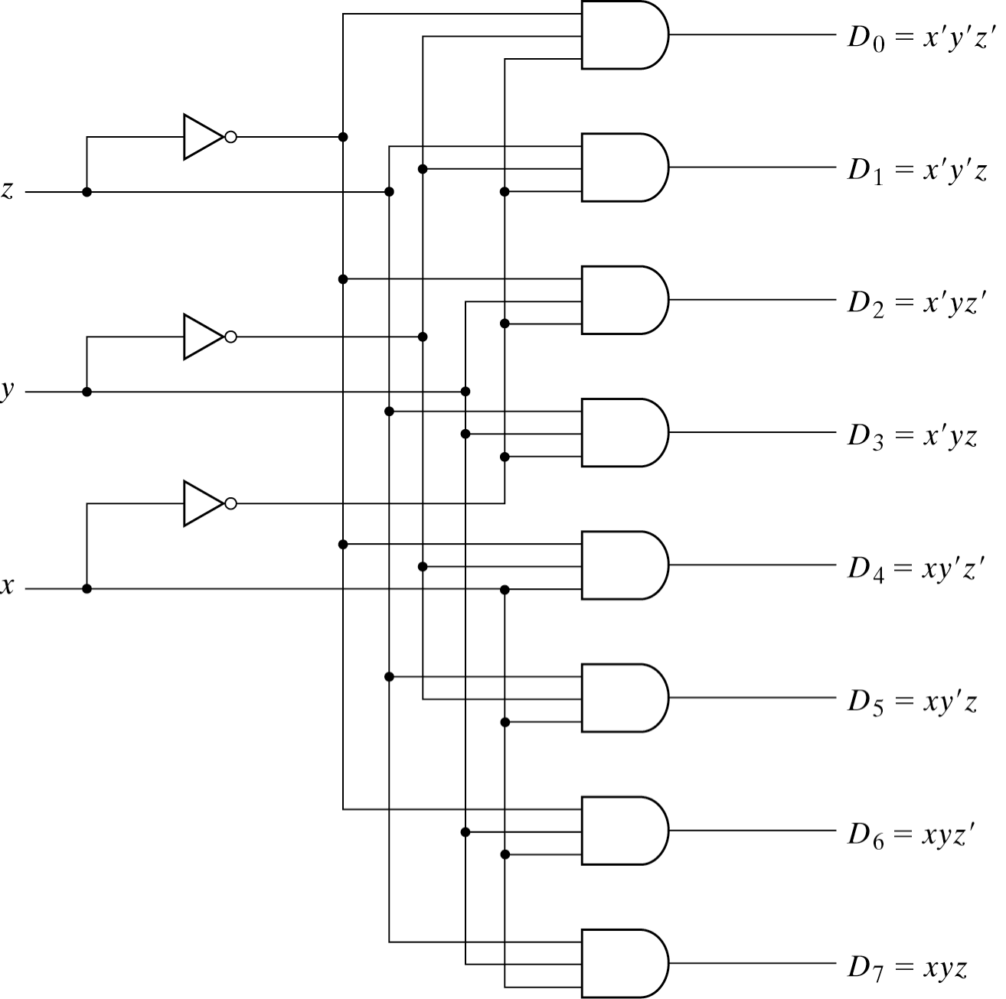
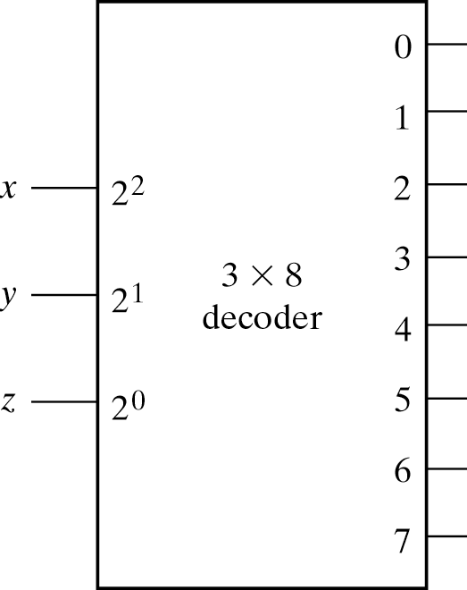
3 to 8 decoder Logic Circuit
Lecture 4 – 41
Minterms
n inputs for 2^{n} outputs
All the minterms are available in outputs (Minterm generator)

Slide 42
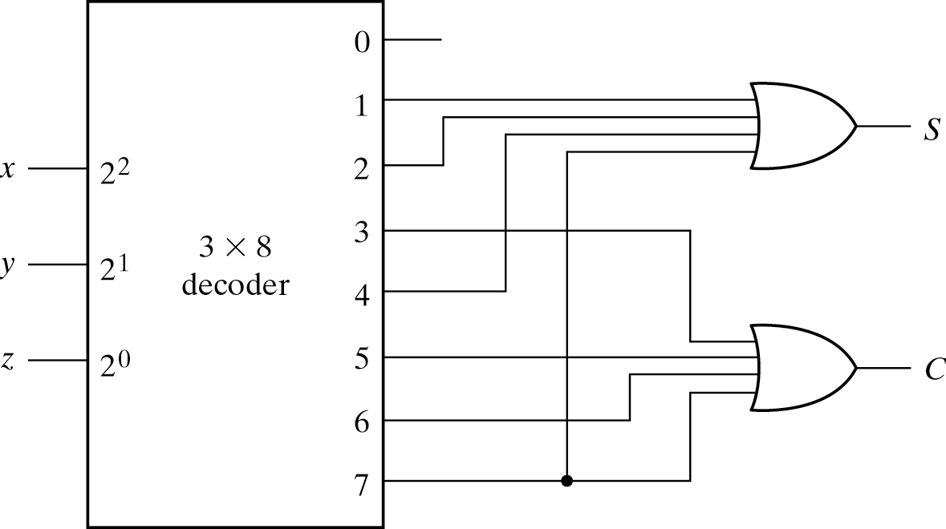
Logic Design with Decoders
Lecture 4 – 42
All the minterms are available from the decoder
Sum-of-product form can be implemented with an OR gate
Full Adder Example
  Find minterms from the truth table or canonical form
  Connect the inputs to the decoder in the right order
    x = A, y = B and z = Cin
  OR the decoder outputs for Sum and Carry-out
A | B | Cin | Sum | Cout
0 | 0 | 0 | 0 | 0
0 | 0 | 1 | 1 | 0
0 | 1 | 0 | 1 | 0
0 | 1 | 1 | 0 | 1
1 | 0 | 0 | 1 | 0
1 | 0 | 1 | 0 | 1
1 | 1 | 0 | 0 | 1
1 | 1 | 1 | 1 | 1

Slide 43
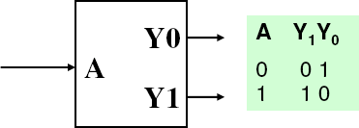
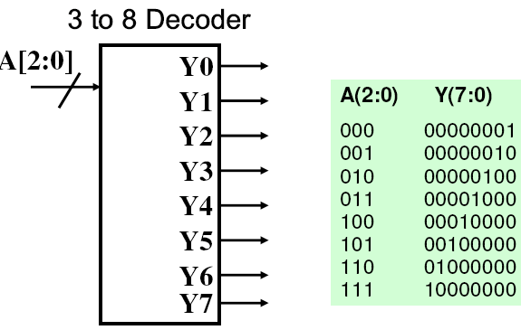
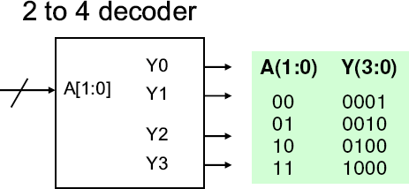
Decoders – n inputs to 2^{n} outputs
Lecture 4 – 43
For a particular input combinations ,only the corresponding output (out of all 2^{n} outputs) will be equal to 1, the rest of the outputs are 0.
1 to 2 decoder
A’
A₂’A₁’A₀’ A₂’A₁’A₀ A₂’A₁A₀’ A₂’A₁A₀ A₂A₁’A₀’ A₂A₁’A₀ A₂A₁A₀’ A₂A₁A₀
A
A₁’A₀’ A₁’A₀
A A ’
1 0
A A
1 0

Slide 44
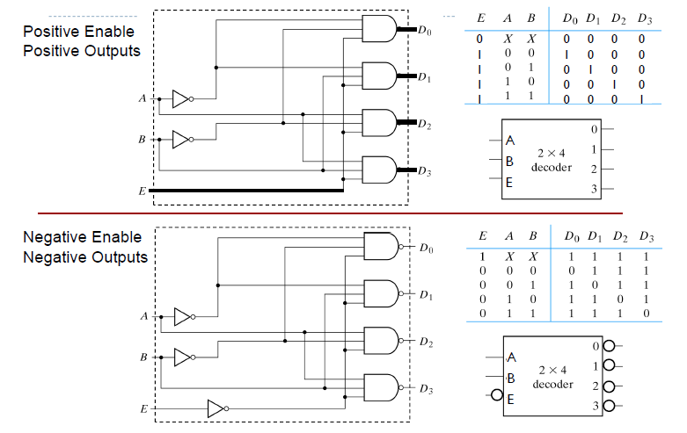
EDLECe22c00oFadll 2e01r4s– L.Ywobaisth +/- Enable Inputs and +/- outputs
Lecture 4 – 44

Slide 45
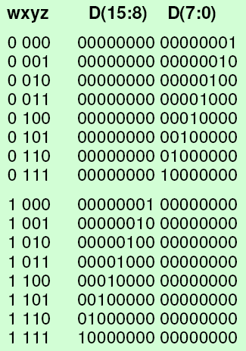
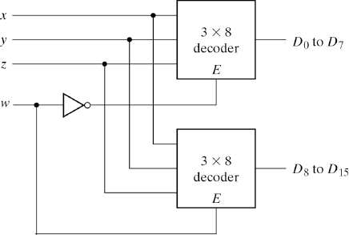
Decoder Architectures
Lecture 4 – 45
Larger decoders can be constructed from smaller decoders
  E.g. 4-16 decoder from 2*3-8 decoders

Slide 46
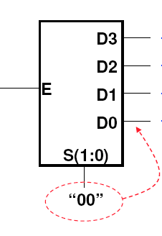
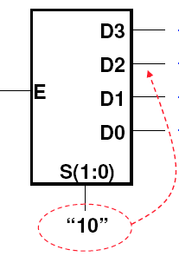
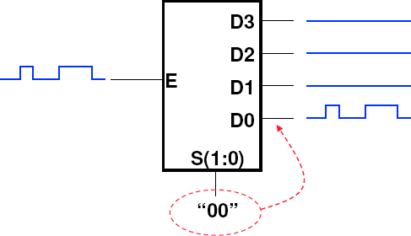
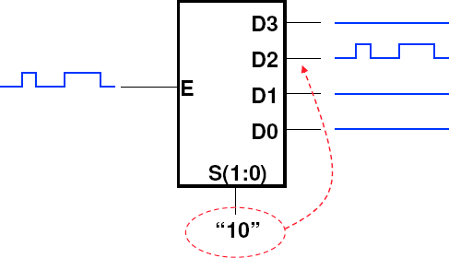
Decoder/Demultiplexer
Lecture 4 – 46
Decoder with Enable input works as a demultiplexer
When En=0, all the outputs are zero.
When En=1, only the selected output is 1 while all the remaining outputs are zero.
When En=0
When En=1
0
1
0
0
When En=0 When En=1
0
0
0
0
0
0
0
1
0
0
0
0
En=0
En=1
En=0
En=1
It directs the signal from one input line (E) into one (selected by S) of the output lines (DN…D0)

Slide 47
Decoder/Demultiplexer Architecture
Lecture 4 – 47
Larger Decoder can be made of smaller ones, similarly
Note the most significant bit (MSB) A is at the first stage
A 3-to-8 decoder can be made of 7 1-to-2 decoders or 2 2-to-4 decoders and 1
1-to-2 decoder
G is the ENABLE for the entire circuit
0
1
D₀ D₀ = GA’B’C’
D
En
S C
D = GA’B’C
0
1
1
En
S 1
B
D = GA’B C’
0
D
2
2
D₃ = GA’B C
En
S 1 C
D₃
G
En
0
S 1
A
0
D₄ D₅
D₄ = GA B’C’ D₅ = GA B’C
En
S 1
C
G=1,A=1,B=0,C=1
En
0
S 1
B
0
D₆ D₇
D₆ = GA B C’ D₇ = GA B C
En
S 1
C

Slide 48
Decoder/Demultiplexer Architecture
Lecture 4 – 48
Larger Decoder can be made of smaller ones, similarly
Note the most significant bit (MSB) A is at the first stage
A 3-to-8 decoder can be made of 7 1-to-2 decoders or 2 2-to-4 decoders and 1
1-to-2 decoder
G is the ENABLE for the entire circuit
0
1
D₀ D₀ = GA’B’C’
D
En
S C
D = GA’B’C
0
1
1
En
S 1
B
D = GA’B C’
0
D
2
2
D₃ = GA’B C
G=1,A=0,B=1,C=0
En
S 1 C
D₃
G
En
0
S 1
A
0
D₄ D₅
D₄ = GA B’C’ D₅ = GA B’C
En
S 1
C
En
0
S 1
B
0
D₆ D₇
D₆ = GA B C’ D₇ = GA B C
En
S 1
C

Slide 49
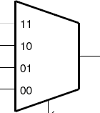


Demultiplexer (deMux) & Multiplexer (Mux)
Lecture 4 – 49
Demultiplexer (deMux) directs the signal from one input line (E) into one (selected by S) of the output lines (DN…D0)
Multiplexer (Mux) directs the signal from one of the input lines (selected by S) into single output line
“00”
“10”

Slide 50
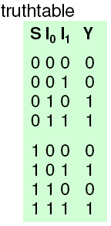
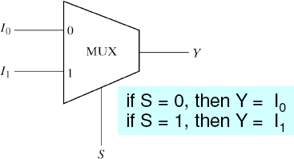
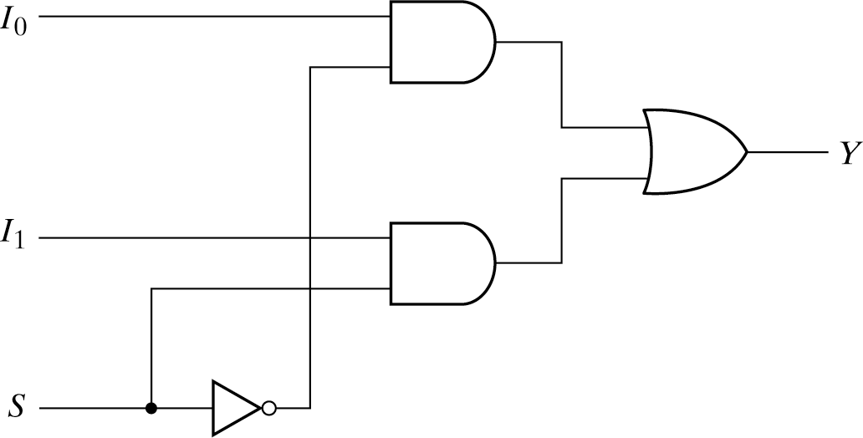
Multiplexers
Lecture 4 – 50
Used to select data from many input sources and direct it to one destination
2^{n} data inputs, n select inputs and 1 output
The n select inputs select one of 2^{n} data inputs lines to the output line

Slide 51
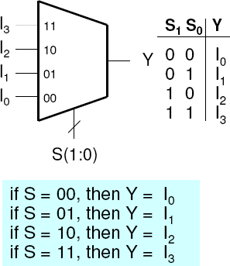


4-to-1 Multiplexers
Lecture 4 – 51
Minterms
I₀S₁’S₀’
I₁S₁’S₀
I₂S₁S₀’
I₃S₁S₀
Minterms

Slide 52

Logic Design with the Multiplexer
Lecture 4 – 52
All the minterms are available to the multiplexer inputs
  Connect the function inputs (literals x, y, z…) to the select inputs
  Assign 0 or 1 to the data inputs according to the truth table
F(x, y,z) = ∑m(1,2,6,7)
z y x
x | y | z | F
0 | 0 | 0 | 0
0 | 0 | 1 | 1
0 | 1 | 0 | 1
0 | 1 | 1 | 0
1 | 0 | 0 | 0
1 | 0 | 1 | 0
1 | 1 | 0 | 1
1 | 1 | 1 | 1

Slide 53

Logic Design with the Multiplexer (MUX)
Lecture 4 – 53
Use smaller multiplexer for implementation
  Start from MSB and assign the function inputs to SELECT inputs of MUX
  Remaining inputs goes to DATA inputs of MUX
  Partition the truth table into smaller segments according to the inputs assigned to SELECT inputs
  Number of partitions should be equal to number of DATA inputs
  Assign 0, 1, z and z’ to the DATA inputs
F(x, y,z) = ∑m(1,2,6,7)

Slide 54

More Design Examples with Multiplexer
Lecture 4 – 54
For a 4-input combinational function
  16-to-1 multiplexer: look-up table
    Simply assign the output function to the data inputs
  How about using 8-to-1 multiplexer?
F(A,B,C,D) = ∑m(1,3, 4,11,12,13,14,15)

Slide 55




Various Design Implementations
Lecture 4 – 55
F(A,B,C,D) = Σm(0,1,3,6,7,8,11,12,14).
  a) By only NAND gates (equivalent to AND-OR or sum of Minterms)
  b) By only NOR gates (equivalent to OR-AND or product of Maxterms)
AB CD
00
A
00 01 11 10
0 1 1
1
1
a)
F = B’CD + A’B’C’ + A’BC + ABD’ + B’C’D’
(B’CD in the only essential prime implicant, there are other equivalent good expressions)
01
0
0
0
11 1
^{C} 10 0
D
1
1
0
1
1 0
A
b)
F’ = B’CD’ + A’BC’ + ABD + AC’D
(the most simplified Boolean epression, All four minterms are essential)
B
AB
_{CD} 00 01 11 10
00 1 1 1
0
0
01 1
11 1
^{C} 10 0 1 1 0
0 0
0 1
D
1
F = (B+C’+D)(A+B’+C)(A’+B’+D’)(A’+C+D’)
B

Slide 56
Various Design Implementations, Continued
Lecture 4 – 56
F(A,B,C,D) = Σm(0,1,3,6,7,8,11,12,14).
– c) By a 4:16 decoder/demultiplexer (and an OR gate)
Outputs are the minterms!
0
1
2
3
4
5
6
7
8
9
10
11
12
13
14
15
F
1
4:16
Decoder
SOP
Enable = 1
S3 S2 S1 S0
A B C D

Slide 57
Various Design Implementations, Continued
Lecture 4 – 57
A B C D F
0 0 0 0 1
0 0 0 1 1
0 0 1 0 0
0 0 1 1 1
0 1 0 0 0
0 1 0 1 0
0 1 1 0 1
0 1 1 1 1
1 0 0 0 1
1 0 0 1 0
1 0 1 0 0
1 0 1 1 1
1 1 0 0 1
1 1 0 1 0
1 1 1 0 1
1 1 1 1 0
F(A,B,C,D) = Σm(0,1,3,6,7,8,11,12,14).
– d) By an 8:1 multiplexer (and an inverter)
A, B, C assigned to SELECT inputs! Partition the truth table accordingly
For each partition → A, B, C remains same
F = 1
F = D
F = 0
1 0
D 1
0
1
D’ D
F = 1
2
3
4
5
F = D’
8:1
MUX
F
F = D
D’ 6
D’ 7 S2 S1 S0
A B C
F = D’
F = D’

Slide 58
Various Design Implementations, Continued
Lecture 4 – 58
A B C D F
0 0 0 0 1
0 0 0 1 1
0 0 1 0 0
0 0 1 1 1
0 1 0 0 0
0 1 0 1 0
0 1 1 0 1
0 1 1 1 1
1 0 0 0 1
1 0 0 1 0
1 0 1 0 0
1 0 1 1 1
1 1 0 0 1
1 1 0 1 0
1 1 1 0 1
1 1 1 1 0
F(A,B,C,D) = Σm(0,1,3,6,7,8,11,12,14).
– e) By an 4:1 multiplexer (and some gates)
F = C’ + D
A, B assigned to SELECT inputs! Partition the truth table accordingly
For each partition → A, B remains same Write a function for each partition using minimized SOP or POS of remaining literals (e.g. C, D)
F = C
C’ + D
0
C
1
4:1
MUX
F
F = C XNOR D
2
C XNOR D
D’
3
S1 S0
F = D’
A B

Slide 59
Various Design Implementations, Continued
Lecture 4 – 59
A | B | C | D | F | F(A,B,C,D) = Σm(0,1,3,6,7,
0 | 0 | 0 | 0 | 1 | – f) By an 2:1 multiplexer (and mo
0 | 0 | 0 | 1 | 1 | A assigned to SELECT inpu
0 | 0 | 1 | 0 | 0 | Partition the truth table acco
0 | 0 | 1 | 1 | 1 | F = ? For each partition → A rema
0 | 1 | 0 | 0 | 0 | Write a function for each pa
0 | 1 | 0 | 1 | 0 | minimized SOP or POS of r
0 | 1 | 1 | 0 | 1 | (e.g. B, C, D)
0 | 1 | 1 | 1 | 1
1 | 0 | 0 | 0 | 1 | ? 0
1 | 0 | 0 | 1 | 0
1 | 0 | 1 | 0 | 0
1 | 0 | 1 | 1 | 1 | F = ? ^{? 1}
1 | 1 | 0 | 0 | 1 | S
1 | 1 | 0 | 1 | 0
1 | 1 | 1 | 0 | 1
1 | 1 | 1 | 1 | 0
8,11,12,14).
re gates)
t! rdingly
ins same rtition using
emaining literals
2:1
MUX
F
0
A

Slide 60
Various Design Implementations, Continued
Lecture 4 – 60
A | B | C | D | F
0 | 0 | 0 | 0 | 1
0 | 0 | 0 | 1 | 1
0 | 0 | 1 | 0 | 0
0 | 0 | 1 | 1 | 1
0 | 1 | 0 | 0 | 0
0 | 1 | 0 | 1 | 0
0 | 1 | 1 | 0 | 1
0 | 1 | 1 | 1 | 1
1 | 0 | 0 | 0 | 1
1 | 0 | 0 | 1 | 0
1 | 0 | 1 | 0 | 0
1 | 0 | 1 | 1 | 1
1 | 1 | 0 | 0 | 1
1 | 1 | 0 | 1 | 0
1 | 1 | 1 | 0 | 1
1 | 1 | 1 | 1 | 0
F(A,B,C,D) = Σm(0,1,3,6,7,8,11,12,14).
– f) By an 2:1 multiplexer (and more gates)
B C
B
D
 | 00 | 01 |  | 11 | 10
0 | 1 | 0 |  | 1 | 0
1 | 1 | 1 |  | 1 | 0
 |  |  | C
_{B C} B
 | 00 | 01 |  | 11 | 10
0 | 1 | 0 |  | 1 | 1
1 | 0 | 1 |  | 0 | 0
 |  |  | C
F = (B + C’ + D) (B’ + C)
D
F = C’D’ + BD’ + B’CD

Slide 61


Various Design Implementations, Continued
Lecture 4 – 61

Slide 62
Various Design Implementations, Continued
Lecture 4 – 62
 | A | B | C | D | F | F(A,B,C,D) = Σm(0,1,3,6,7,8,11,12,14).
 | 0 | 0 | 0 | 0 | 1 | m0 m1 m2 m3 | – g) By a 4:1 MUX, a 2:4 decoder and 4 OR gat A, B assigned to SELECT inputs of MUX! Partition the truth table accordingly For each partition → A, B remains same Identify minterms for each partition Get those minterms from DECODER outputs by placing remaining literals (e.g. C, D) inputs to the DECODER OR minterms to create canonical SOP of remaining literals (e.g. C, D)
 | 0 | 0 | 0 | 1 | 1
 | 0 | 0 | 1 | 0 | 0
 | 0 | 0 | 1 | 1 | 1
 | 0 | 1 | 0 | 0 | 0 | m0 m1 m2 m3
 | 0 | 1 | 0 | 1 | 0
 | 0 | 1 | 1 | 0 | 1
 | 0 | 1 | 1 | 1 | 1
 | 1 | 0 | 0 | 0 | 1 | m0 m1 m2 m3
 | 1 | 0 | 0 | 1 | 0
 | 1 | 0 | 1 | 0 | 0
 | 1 | 0 | 1 | 1 | 1
 | 1 | 1 | 0 | 0 | 1 | m0 _{m1} Connect OR outputs to the appropriate DATA inputs _{m2} of MUX m3
 | 1 | 1 | 0 | 1 | 0
 | 1 | 1 | 1 | 0 | 1
 | 1 | 1 | 1 | 1 | 0
es
of

Slide 63


Slide 64
Exercise
Lecture 4 – 64
Implement a 4X1 multiplexer using a 2X4 decoder, four AND gates and one OR gate

Slide 65
Multiplexer Architecture
Lecture 4 – 65
Larger Multiplexer can be made of smaller ones, too
  Note the most significant bit (MSB) A is at the final stage
  A 8-to-1 multiplexer can be made of 7 2-to-1 multiplexers or 2 4-to-1 multiplexers and 1 2-to-1 multiplexer
I₀
I₁
0
1 S
C
0
1 S
C
0
1 S
C
0
0
1 S
B
I₂
I₃
0 Y
1 S
A
I₄
I₅
0
1 S
B
Y = A' B' C' I₀ + A' B' C I₁ + A' B C' I₂
I
6
I
+ A' B C I₃ + A B' C' I₄ + A B' C I₅
+ A B C' I₆ + A B C I₇
7
1
S
C

Slide 66


Multi-bit multiplexers
Lecture 4 – 66
Muxes are often used to select groups of bits arranged in buses.
  E.g. 4-to-1 8-bit mux
Using 8 1-bit MUX’es

Slide 67

Multiplexer/Demultiplexer
Lecture 4 – 67
Floyd, Digital Fundamentals

Slide 68

Driving Buses
Lecture 4 – 68
 Multiplexers are often used when we have a system with a bus that needs to be driven from multiple source blocks, when only one block is driving the bus at a time
 N-to-1 mux will select 1 source; select bus needs to be log2(N)
 Note that only ONE input can be selected at a time.

Slide 69

Lecture 4 – 69
Decoders
Converts binary information to non-binary form
Floyd, Digital Fundamentals

Slide 70


Lecture 4 – 70
Decoders
Converts binary information to non-binary form
Floyd, Digital Fundamentals

Slide 71

Encoders
Lecture 4 – 71
Converts non-binary information to binary form
Usually more input bits to fewer output bits
Inverse operation of (N to 2^{N}) decoder is (2^{N} to N) encoder
Only one of the inputs can be “1” while other inputs “0”
For example, 8-to-3 encoder:
  00010000 -> 101
  00110000 -> ???
Typically used 2^{N} to N encoder is Priority Encoder
Other Encoders/Decoders include
  Thermometer code to Binary
  BCD to 7-segment
  Binary to Gray Code
  etc.

Slide 72
Lecture 4 – 72
Reading assignment
 Chapter 4.1 to 4.10 of textbook

